Slide 1
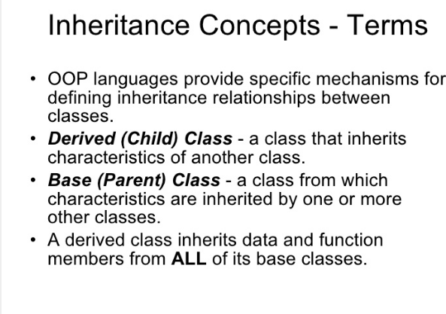

Slide 2
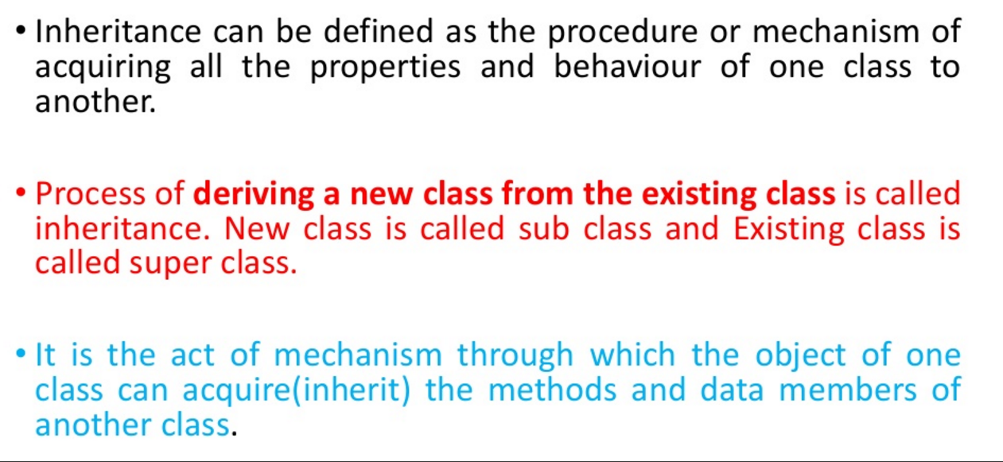

Slide 3
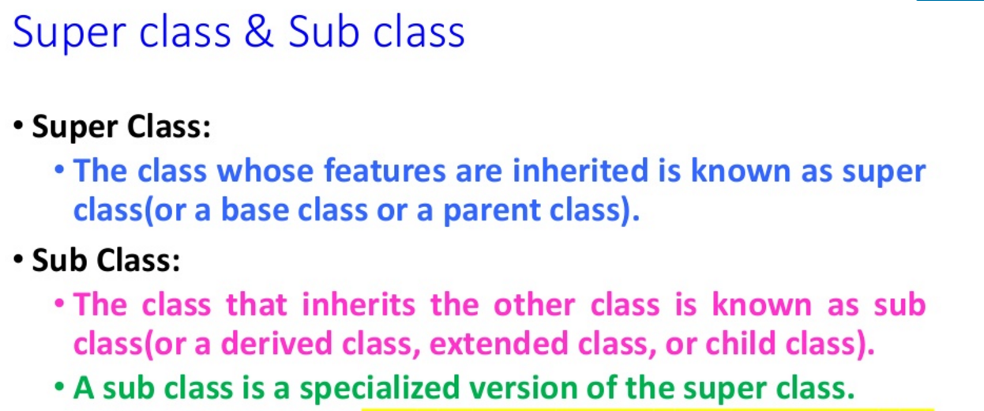

Slide 4
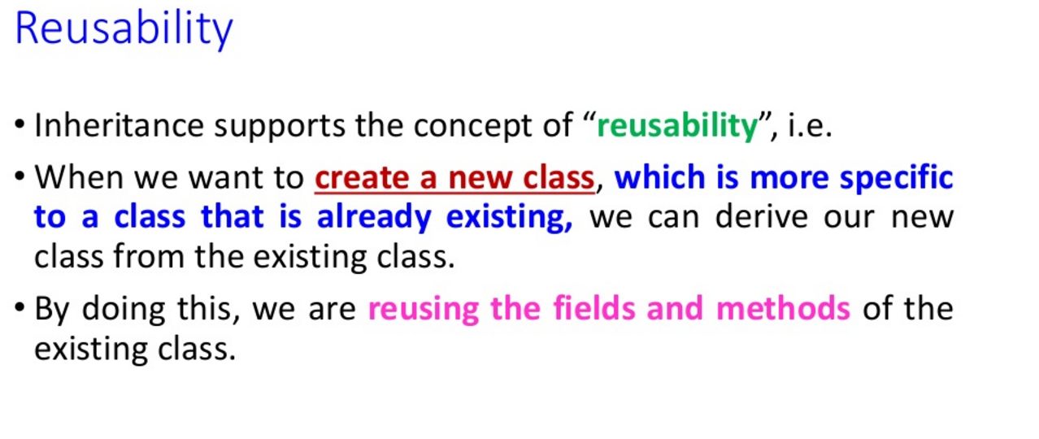

Slide 5
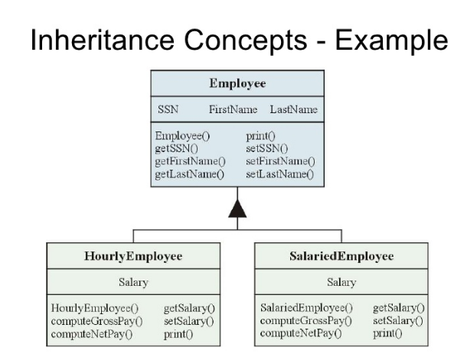

Slide 6
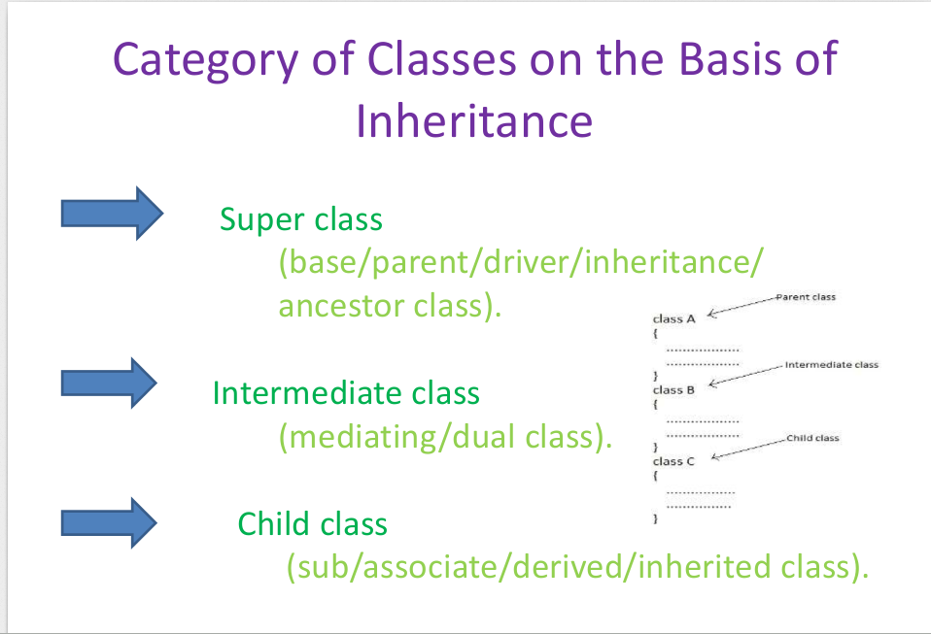

Slide 7
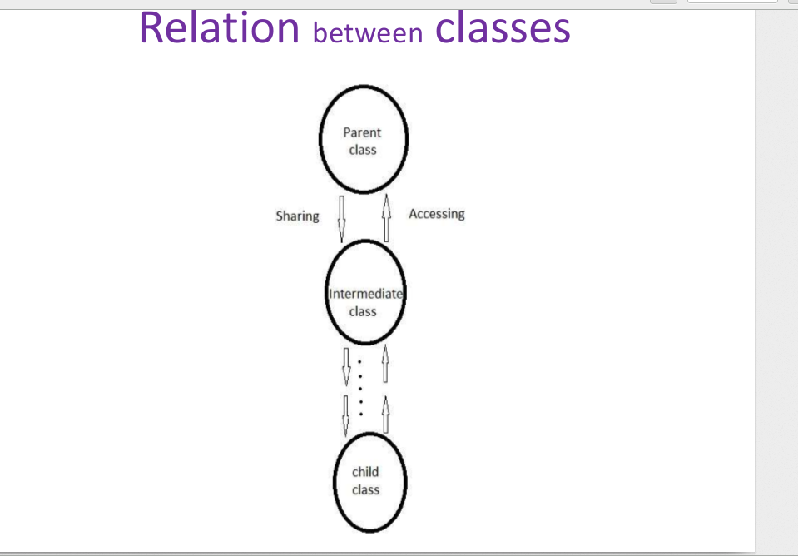

Slide 8
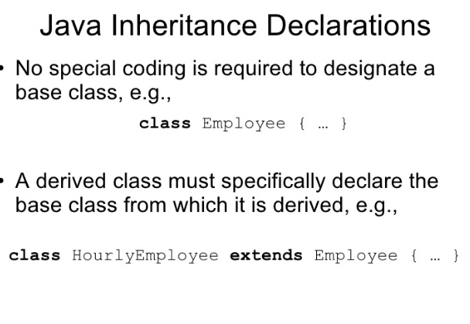

Slide 9
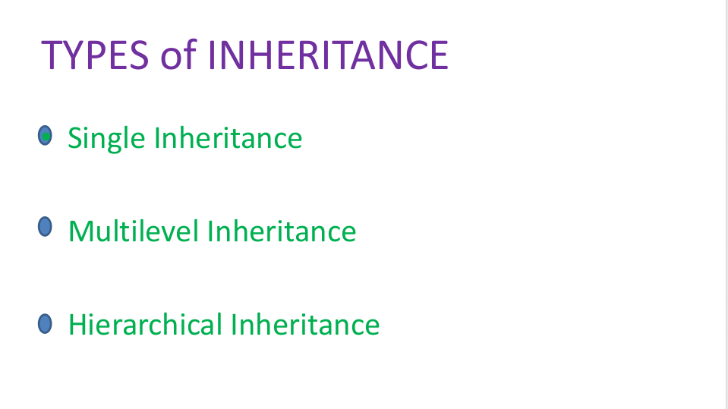

Slide 10
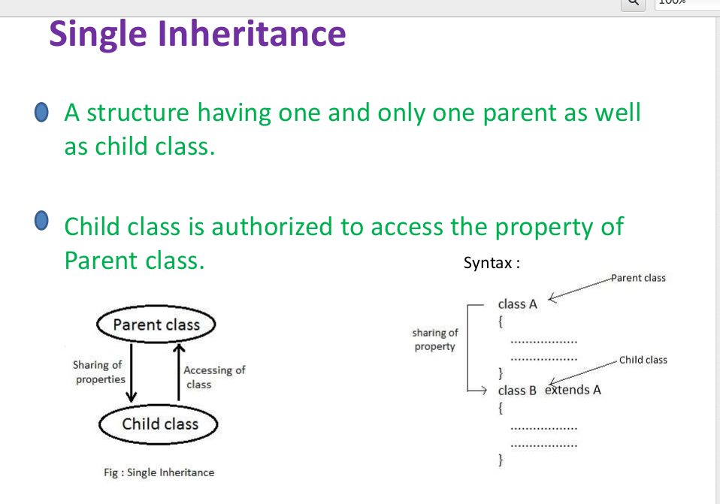

Slide 11
class A
{
void A1()
{System.out.println("A");}
}
public class B extends A{
void B1()
{System.out.println("B");
}
public static void main(String args[])
{
B obj = new B();
obj.A1();
obj.B1();
}
}
OutPut-
A
B

Slide 12
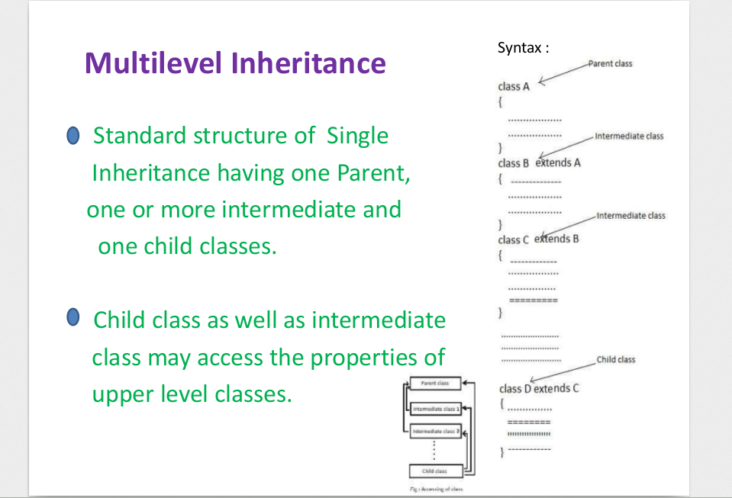

Slide 13
class A
{
void A1()
{System.out.println("A");}
}
class B extends A
{
void B1()
{System.out.println("B");}
}
public class C extends B{
void C1()
{System.out.println("C");
}
public static void main(String args[])
{
C obj = new C();
obj.A1();
obj.B1();
obj.C1();
}
}
Output -
A
B
C

Slide 14
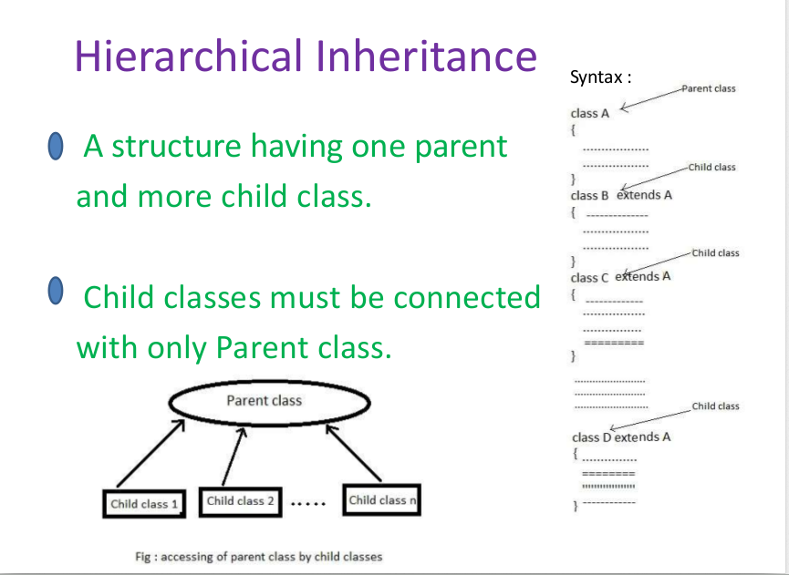

Slide 15
A
B
C
D

Slide 16
class A
{
public void methodA()
{
System.out.println("method of Class A");
}
}
class B extends A
{
public void methodB()
{
System.out.println("method of Class B");
}
}
class C extends A
{
public void methodC()
{
System.out.println("method of Class C");
}
}
class D extends A
{
public void methodD()
{
System.out.println("method of Class D");
}
}
public class JavaExample
{
public static void main(String args[])
{
B obj1 = new B();
C obj2 = new C();
D obj3 = new D();
//All classes can access the method of
// class A
obj1.methodA();
obj2.methodA();
obj3.methodA();
}
}
OutPut
method of Class A
method of Class A
method of Class A

Slide 17
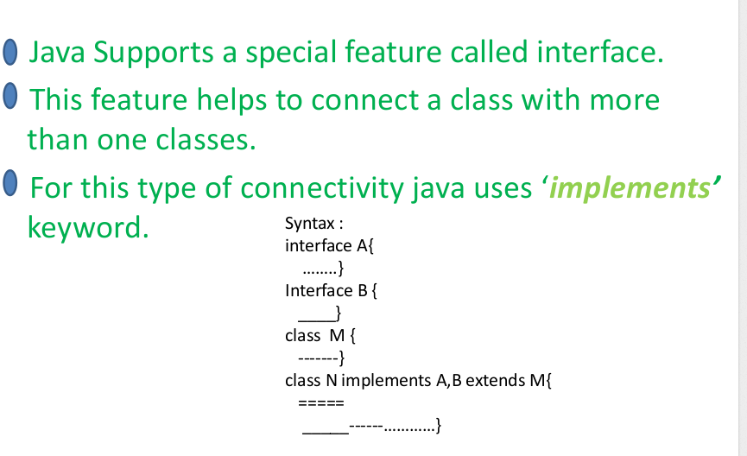
Interface

Slide 18
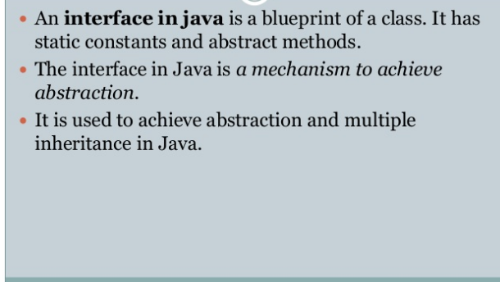

Slide 19
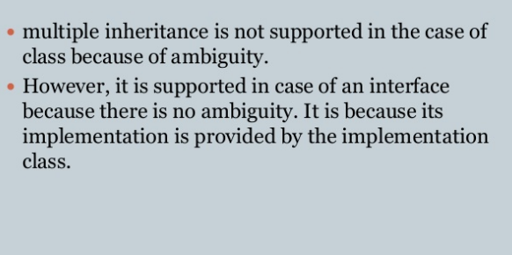

Slide 20
interface A {
public void myMethod(); // interface method
}
interface B {
public void myOtherMethod(); // interface method
}
class C implements A, B {
public void myMethod() {
System.out.println("A");
}
public void myOtherMethod() {
System.out.println("B");
}
}
public class MyMainClass {
public static void main(String[] args) {
C myObj = new C();
myObj.myMethod();
myObj.myOtherMethod();
}
}
A
B

Slide 21
Method Overriding
In a class hierarchy, when a method in a subclass has the same name and type signature as a method in its superclass, then the method in the subclass is said to override the method in the superclass.
When an overridden method is called from within its subclass, it will always refer to the version of that method defined by the subclass.
The version of the method defined by the superclass will be hidden.

Slide 22
class Vehicle
{
void run(){System.out.println("Vehicle");
}
}
class Bike2 extends Vehicle
{
void run(){System.out.println("Bike");}
public static void main(String args[]){
Bike2 obj = new Bike2();
obj.run();
}

Slide 23
Dynamic Method Dispatch
Method overriding forms the basis for one of Java’s most powerful concepts: dynamic method dispatch.
Dynamic method dispatch is the mechanism by which a call to an overridden method is resolved at run time, rather than compile time.
Dynamic method dispatch is important because this is how Java implements run-time polymorphism.

Slide 24
class A {
void callme() {
System.out.println("Inside A's callme method");}}
class B extends A {
void callme() {
System.out.println("Inside B's callme method");}}
class C extends A {
// override callme()
void callme() {
System.out.println("Inside C's callme method");}}
class Dispatch {
public static void main(String args[]) {
A a = new A(); // object of type A
B b = new B(); // object of type B
C c = new C(); // object of type C
A r;
r = a; // r refers to an A object
r.callme();
r = b; // r refers to a B object
r.callme();
r = c; // r refers to a C object
r.callme();
}
}
The output from the program is shown here:
Inside A's callme method
Inside B's callme method
Inside C's callme method

